Slide 1
Request Model (Short Version)
Extraction Oil and Gas
By Gerard Gilliland
July 26, 2017
Not Associated with Extraction Oil and Gas or Broomfield County
This presentation at: http://www.modelsw.com/OilGasMonitor/index.html
You are welcome to copy and share this presentation and data.
I suspect the papers I reference are copyrighted and I have not asked permission to use their papers.
Notes:
This Study is independent of Extraction and Broomfield.
I am attempting to present the facts in an unbiased manner.
But I think forcing or accepting an industrial process in a residential area is wrong.

Slide 2
Request for a 20 well 2 year model
This presentation is not about pad count and size (although I do meander there).
It is comparing Extraction’s Gantt chart where frac and flowback is indiscriminate to one where frac and flowback is limited to summer months.
The two studies both peak within a month of each other. So the study should show the contaminants in our community where the only difference is the season in which the processes are applied.
Emissions used are from the CSU Collett study:
  Drill 6 g/sec; Frac 29 g/sec; Flowback 54 g/sec.

Slide 3
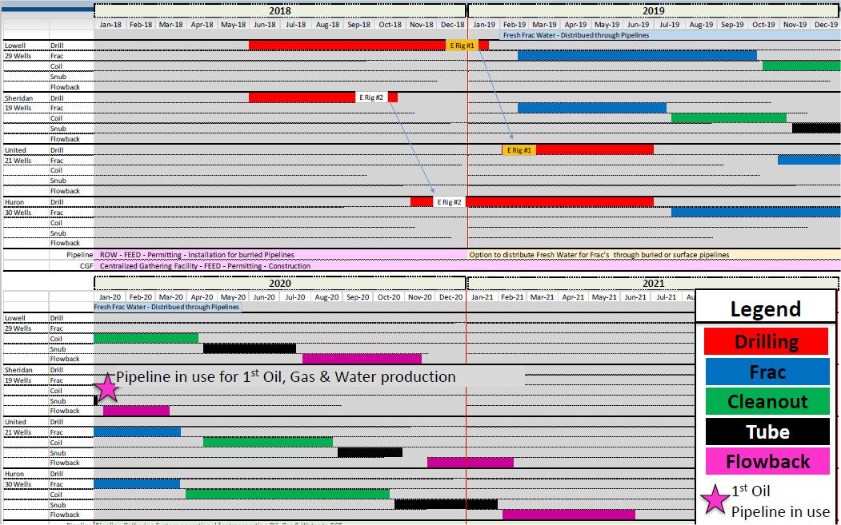
Drill, Frac, Flowback Schedule
Notes:
Operations on multiple sites at the same time.
Two drillers.
No regard to season.
Drill, Frac, Cleanout, Tube, Flowback, Production

Slide 4
Extraction’s Gantt Chart – 4 pads
Plus Coyote Estimate

Slide 5
Schedule Criteria
Recognizing the highest emissions by far occur in the winter, the highest sources of emissions are Fracking and Flowback, with drilling a distant third, and using Extraction’s Gantt chart average times, I developed a
20 well 2 year schedule:
  Drill any 5 months between October and March
  Frac mid April to mid September
  Cleanout mid September through January
  Tube February through April
  Flowback May through August
  Production start in September
I don’t have any emissions numbers on Cleanout and Tube. I can’t believe they are zero, but since they aren’t discussed, I assume they are low.
It is important to note that the next three charts are EMISSIONS (g/sec) from the pad available for input to AERMOD not CONCENTRATIONS (ug/m^3) or ppb in the areas surrounding the pads as an output of AERMOD. The same emission can produce different concentrations depending upon the time of year and time of day.

Slide 6
Summer Frac, Flowback – 1 Drill

Slide 7
Summer Frac, Flowback – 2 Drills

Slide 8
Details and Request
The details and previous three graphs are in:
http://www.modelsw.com/OilGasMonitor/PressuresVolumesFlows5Pads.xlsx
Sheets: GanttChart, SummerFrac, and SummerFracTwo
I would like the AERMOD consultant to compare GanttChart and SummerFracTwo?
I have calculated the grams / second for AERMOD input for all process.
I can show the consultant the locations in the above spreadsheet
But if the consultant has better numbers they can be substituted and used in both studies.
If Extraction submits a Gantt chart for Coyote, I will use that rather than my estimation.

Slide 9
EPA AERMOD and AERMET
This page is included for posterity .
AERMET – weather data
  Hourly surface from Erie Airport
  Twice daily weather balloons from Stapleton
  https://www3.epa.gov/ttn/scram/7thconf/aermod/aermet_userguide.pdf
  Erie Airport surface data: 720534 ERIE, CO
  https://gis.ncdc.noaa.gov/maps/ncei/cdo/hourly
  Upper Air data: 23062 STAPLETON, CO
  https://esrl.noaa.gov/raobs/
AERMOD – Calculate dispersion of contaminants
  Input: emission source g/s
  Output: concentrations Average and Max ug/m^3 for Hour, Day, Month, and Year.
  https://www3.epa.gov/ttn/scram/models/aermod/aermod_userguide.pdf
Notes:
These two EPA programs take weather, and grams per second
And calculate micrograms per cubic meter at selected distances.

Slide 10
Concentrations From Fracking
http://www.modelsw.com/OilGasMonitor/SheridanPadCart.php

Slide 11
Percent Concentration By Hour

Slide 12
Percent Concentration by Month
Don't allow Fracking or Flowback during the Winter

Slide 13
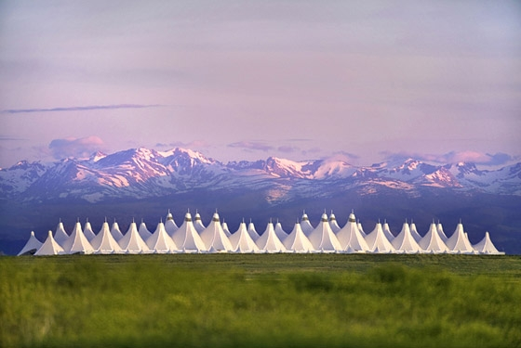
The best for public safety
(next to not drilling): A Tent
Use the Denver Airport Roof Concept
All the work will be conducted underneath with a vent to a flare at the top.
Mount an infrared camera and sensor inside.
Potential decrease emissions rates by 36 times.
If Extraction can buy a million dollars worth of butterflies, he can buy a tent.
Notes:
I think you should put the whole pad under a tent.
A vent and flare at the top will decrease greenhouse gasses by 97 percent.
A carbon filter can capture any contaminant.

Slide 14
In Summary – I recommend:
Only Allow the 20 well (or less), 2 year, 1 drill schedule with Frac and Flowback in the Summer.
A Tent – I can get you a contact.
Unrelated
  They started fracking in Triple Creek about a week ago. It should continue for another 4 ½ months. Would you please take your calibrated mic and a couple of canisters and get some readings?
Notes:
My recommendations

Slide 15
Questions
What Emission rates did SLR use in their model?
Who provided those rates?
Why is Flowback not mentioned in the report?
Is SLR providing AERMOD.OUT and the associated PLOTFILEs?
How does CDPHE AERMET data differ from SURFDATA 720534 2016 EIRE, CO and UAIRDATA 23062 2016 STAPLETON, CO ?

